Slide 1



Agent
LRM Module 5
Standing Committee on Training
Program for Cooperative Cataloging (PCC)
March 2020

Slide 2
Learning outcomes
At the end of this module, you will be able to:
Define what Agents are
Explain the differences within Agents between FRBR and LRM
Identify the attributes of Agents
Identify the relationships associated with Agents
Identify the subclasses of Agents and their attributes and relationships

Slide 3
Agent [LRM-E6]
An entity capable of deliberate actions, of being granted rights, and of being held accountable for its actions.
A superclass strictly equivalent to the union of the entities Person and Collective Agent
Reduces redundancy in the LRM model by providing a single entity to serve as the domain or range of certain relationships that apply to all specific types of agents
AGENT

Slide 4
Agent [LRM-E6]—Hierarchy
RES
(entity)
Superclass:
  Res [LRM-E1] (Any entity in the universe of discourse)
Subclasses:
  Person [LRM-E7] (An individual human being)
  Collective agent [LRM-E8] (A gathering or organization
  of persons bearing a particular name and capable of
  acting as a unit)
Disjoint with: none
HAS SUPERCLASS
AGENT
(entity)
HAS SUBCLASSES
PERSON (agent)
COLLECTIVE AGENT
(entity)

Slide 5

Humans are the motive force behind Agent actions
Human beings are directly or indirectly the motive force behind all such actions taken by all agents. Automatons (for example, weather recording devices, software translation programs) are considered tools used and set up by actual Agents
Example: This automaton has the mechanical ability to write a letter. The LRM Agent is, however, the human or humans who created and set up the automaton. The automaton itself is not an Agent
Photo from the Musée d’automates et boîtes à musique, Sainte-Croix, Switzerland

Slide 6
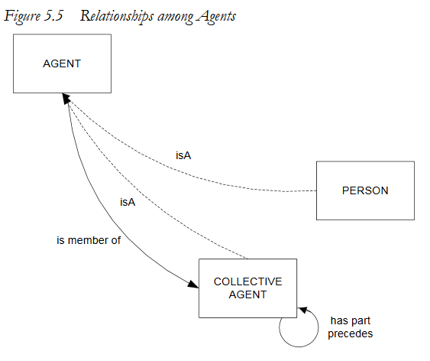
Relationships among Agents
A Person IsA Agent (i.e., subclass of Agent)
A Collective Agent IsA Agent
An Agent is member of Collective Agent
Collective Agent has part Collective Agent
Collective Agent precedes Collective Agent
Inverse relationships have been omitted from the diagram for clarity.

Slide 7
Agents & WEMI
Being an agent requires the potential of intentional relationships with instances of entities of bibliographic interest (works, expressions, manifestations, items), regardless of whether the Agent has ever done so
Examples:
  An author (person agent) creates a work
  A performing group (collective agent) performs a work (an expression)
  A publisher (collective agent) creates a publication (a manifestation)
  A binder (person agent) creates an item

Slide 8
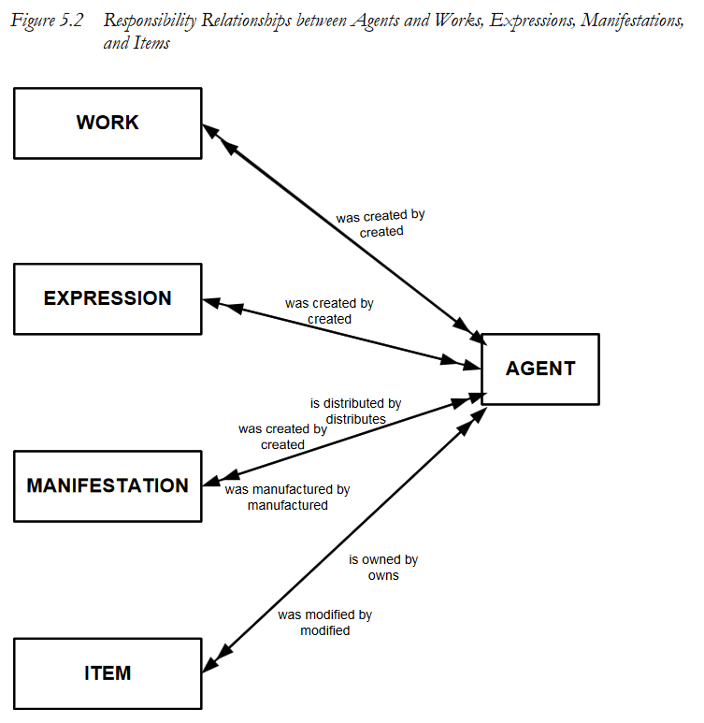
Relationships between Agent & WEMI
From Agent to WEMI:
Agent created Work
Agent created Expression
Agent created Manifestation
Agent distributes Manifestation
Agent manufactured Manifestation
Agent owns Item
Agent modified Item
From WEMI to Agent:
Work was created by Agent
Expression was created by Agent
Manifestation was created by Agent
Manifestation is distributed by Agent
Manifestation was manufactured by Agent
Item is owned by Agent
Item was modified by Agent

Slide 9
Agent Relationships
Rel ID | Domain | Relationship Name | Inverse Name | Range
LRM-R14 | Agent | assigned | was assigned by | Nomen
LRM-R5i | Agent | created | was created by | Work
LRM-R6i | Agent | created | was created by | Expression
LRM-R7i | Agent | created | was created by | Manifestation
LRM-R9i | Agent | distributes | is distributed by | Manifestation
LRM-R30 | Agent | is member of | has member | Collective Agent
LRM-R8i | Agent | manufactured | was manufactured by | Manifestation
LRM-R11i | Agent | modified | was modified by | Item
LRM-R10i | Agent | owns | is owned by | Item

Slide 10
Relationships Inherited from Res
Rel ID | Domain | Relationship Name | Inverse Name | Range
LRM-R13 | Res | has appellation | is appellation of | Nomen
LRM-R33 | Res | has association with | is associated with | Place
LRM-R35 | Res | has association with | is associated with | Time-span
LRM-R1 | Res | is associated with | is associated with | Res
LRM-R12i | Res | is subject of | has as subject | Work

Slide 11
Agent Attributes
Att ID | Attribute | Definition
LRM-E1-A1 | Category | A type to which the res belongs
LRM-E1-A2 | Note | Any kind of information about a res that is not recorded through the use of specific attributes and/or relationships
Attributes inherited from Res
Att ID | Attribute | Definition
LRM-E6-A1 | Contact Information | Information useful for communicating with or getting in contact with the agent
LRM-E6-A2 | Field of activity | A field of endeavour, area of expertise, etc., in which the agent is engaged or was engaged
LRM-E6-A3 | Language | A language used by the agent when creating an expression
Attributes specific to Agents

Slide 12

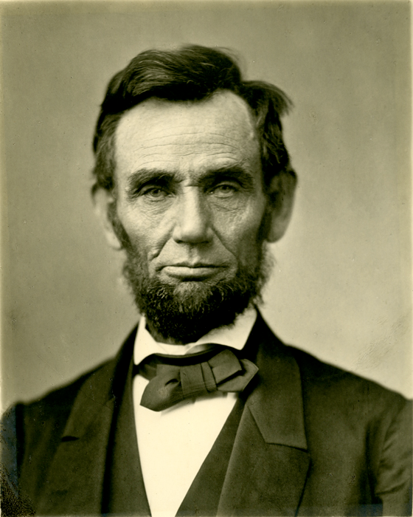
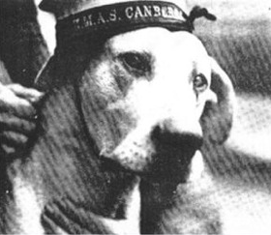
Person [LRM-E7]
An individual human being.
Real persons who live or are assumed to have lived; while strict proof of the existence of a person is not required, there should be general acceptance of their probable historicity
Figures generally considered fictional (for example, Kermit the Frog), literary (for example, Miss Jane Marple) or purely legendary (for example, the wizard Merlin) are not instances of the entity Person
Real animals are not instances of the entity person.
For comparison:
Person (from FRBR)
An individual.
Person (from FRAD)
An individual or a persona or identity established or adopted by an individual or group.
Person (from LRM)
An individual human being
LRM is explicit in saying that a person is a human, unlike FRBR, which is vague, and FRAD, which stresses bibliographic identities
✘
✘
✔

Slide 13


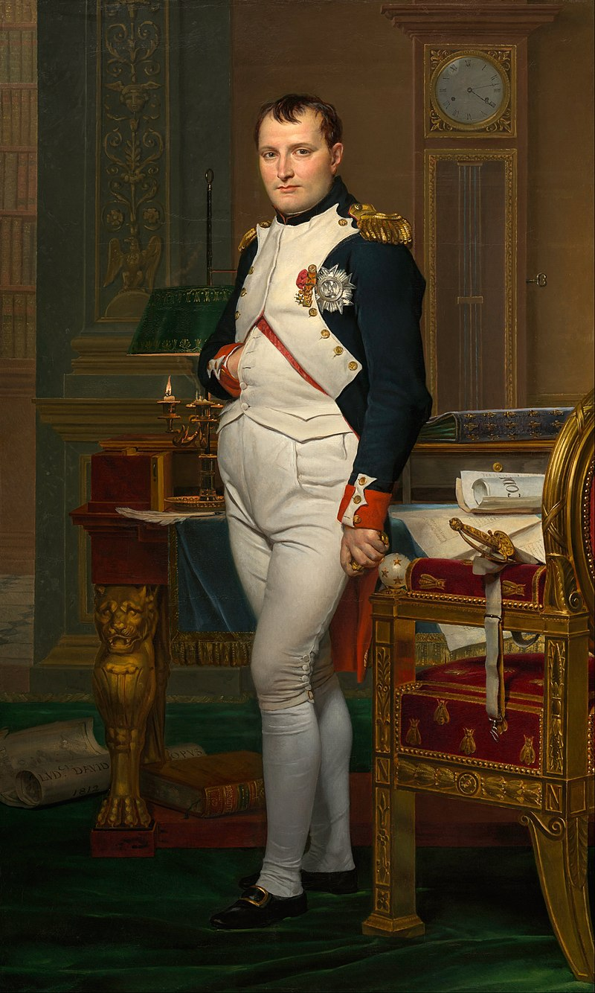


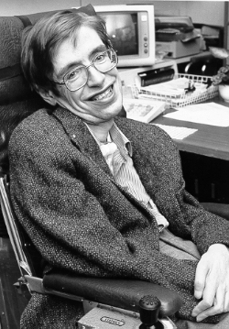
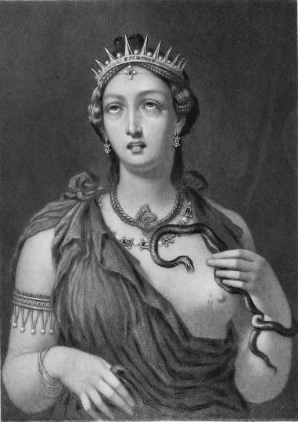
Person [LRM-E7]

Slide 14
Person [LRM-E7]
Superclass:
  Agent [LRM-E6] (An entity capable of deliberate actions, of being granted rights, and of being held accountable for its actions)
Subclass: none
Disjoint with:
  Collective agent [LRM-E8] (A gathering or organization of persons bearing a particular name and capable of acting as a unit)
AGENT
(entity)
HAS SUPERCLASS
HAS SUPERCLASS
PERSON
(entity)
COLLECTIVE AGENT
(entity)
IS DISJOINT WITH

Slide 15
Person Relationships
The Person entity inherits all the relationships from Agent (superclass of Person)…
Rel ID | Domain | Relationship Name | Inverse Name | Range
LRM-R14 | Agent | assigned | was assigned by | Nomen
LRM-R5i | Agent | created | was created by | Work
LRM-R6i | Agent | created | was created by | Expression
LRM-R7i | Agent | created | was created by | Manifestation
LRM-R9i | Agent | distributes | is distributed by | Manifestation
LRM-R30 | Agent | is member of | has member | Collective Agent
LRM-R8i | Agent | manufactured | was manufactured by | Manifestation
LRM-R11i | Agent | modified | was modified by | Item
LRM-R10i | Agent | owns | is owned by | Item
and…

Slide 16
Person Relationships
…all the relationships from Res (superclass of Agent)
Rel ID | Domain | Relationship Name | Inverse Name | Range
LRM-R13 | Res | has appellation | is appellation of | Nomen
LRM-R33 | Res | has association with | is associated with | Place
LRM-R35 | Res | has association with | is associated with | Time-span
LRM-R1 | Res | is associated with | is associated with | Res
LRM-R12i | Res | is subject of | has as subject | Work
Note: LRM does not define any relationships specific to the entity Person

Slide 17
Person Attributes
Attributes inherited from Res
Att ID | Attribute | Definition
LRM-E1-A1 | Category | A type to which the res belongs
LRM-E1-A2 | Note | Any kind of information about a res that is not recorded through the use of specific attributes and/or relationships
Att ID | Attribute | Definition
LRM-E6-A1 | Contact Information | Information useful for communicating with or getting in contact with the agent
LRM-E6-A2 | Field of activity | A field of endeavour, area of expertise, etc., in which the agent is engaged or was engaged
LRM-E6-A3 | Language | A language used by the agent when creating an expression
Attributes inherited from Agent
Attribute specific to Person
Att ID | Attribute | Definition
LRM-E7-A1 | Occupation / Profession | A profession or occupation in which the person works or worked

Slide 18
Collective agent [LRM-E8]
A gathering or organization of persons bearing a particular name and capable of acting as a unit.
Collective agents include families, commercial or corporate entities and other legally registered bodies, organizations and associations, musical, artistic or performing groups, governments, and any of their sub-units
  Occasional groups (for example, meetings, conferences, expeditions, festivals) are instances of the entity Collective agent as long as they are identified by a particular name and can act as a unit
  Joint pseudonyms or collective pseudonyms are Nomens* that refer to instances of the entity Collective agent, since the agent behind the identity consists of two or more persons bearing a particular name and acting as a unit, despite having chosen to be identified by a name culturally associated with individual persons
  Families and corporate bodies are specific types of collective agents that may be relevant in a particular bibliographic application
For comparison:
Corporate body (from FRBR)
An organization or group of individuals and/or organizations acting as a unit.
Corporate body (from FRAD)
An organization or group of persons and/or organizations identified by a particular name acting as a unit.
Family (from FRAD)
Two or more persons related by birth, marriage, adoption, civil union, or similar legal status, or who otherwise present themselves as a family.
There is no equivalent to Collective Agent in FRBR or FRAD.
*See Module 7, Nomen

Slide 19
Collective Agent or just a Group?
Groups of persons that do not qualify as agents are not instances of the entity collective agent. The essential distinction between a collective agent and a gathering of people which is not an instance of the entity collective agent, is that the name used by the instance of the entity must be a specific name and not just a generic description for the gathering
Examples of groups that are not collective agents:
  national, religious, cultural or ethnic groups
  gatherings referred to by a general descriptive term instead of a particular name
A gathering of people is considered a collective agent only when it exhibits organizational characteristics that permit them to perform actions that reflect agency with respect to instances of entities of bibliographic interest. These collective actions may be performed by representatives selected by the whole, rather than by all individual members acting together
Examples of bibliographic agency by collective agents:
  A government agency approved a report
  An academic association published the proceedings of a conference

Slide 20
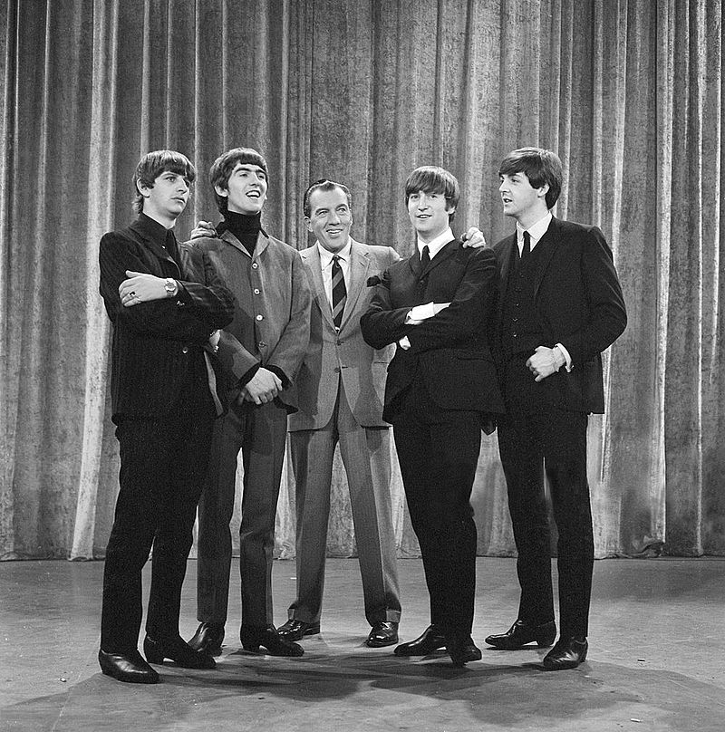

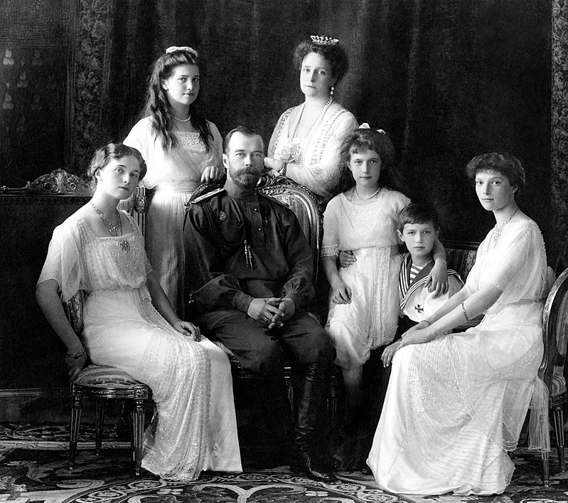




Collective Agent
The Government of the United States
The Beatles
The Romanoff Family
The Government of Canada

Slide 21
Collective agent [LRM-E8]
Superclass:
  Agent [LRM-E6] (An entity capable of deliberate actions, of being granted rights, and of being held accountable for its actions)
Subclass: none
Disjoint with:
  Person [LRM-E7] (An individual human being)
AGENT
(entity)
HAS SUPERCLASS
HAS SUPERCLASS
COLLECTIVE AGENT
(entity)
PERSON
(entity)
IS DISJOINT WITH

Slide 22
Collective Agent Relationships
The Collective Agent has the following unique relationships:
Rel ID | Domain | Relationship Name | Inverse Name | Range
LRM-R30i | Collective Agent | has member | is member of | Agent
LRM-R31 | Collective Agent | has part | is part of | Collective Agent
LRM-R31i | Collective Agent | is part of | has part | Collective Agent
LRM-R32 | Collective Agent | precedes | succeeds | Collective Agent
LRM-R32i | Collective Agent | succeeds | precedes | Collective Agent

Slide 23
Collective Agent Relationships
The Collective Agent entity also inherits all the relationships from Agent (superclass of Collective Agent)…
Rel ID | Domain | Relationship Name | Inverse Name | Range
LRM-R14 | Agent | assigned | was assigned by | Nomen
LRM-R5i | Agent | created | was created by | Work
LRM-R6i | Agent | created | was created by | Expression
LRM-R7i | Agent | created | was created by | Manifestation
LRM-R9i | Agent | distributes | is distributed by | Manifestation
LRM-R30 | Agent | is member of | has member | Collective Agent
LRM-R8i | Agent | manufactured | was manufactured by | Manifestation
LRM-R11i | Agent | modified | was modified by | Item
LRM-R10i | Agent | owns | is owned by | Item
and…

Slide 24
Collective Agent Relationships
…all the relationships from Res (superclass of Agent)
Rel ID | Domain | Relationship Name | Inverse Name | Range
LRM-R13 | Res | has appellation | is appellation of | Nomen
LRM-R33 | Res | has association with | is associated with | Place
LRM-R35 | Res | has association with | is associated with | Time-span
LRM-R1 | Res | is associated with | is associated with | Res
LRM-R12i | Res | is subject of | has as subject | Work

Slide 25
Collective Agent Attributes
Attributes inherited from Res
Att ID | Attribute | Definition
LRM-E1-A1 | Category | A type to which the res belongs
LRM-E1-A2 | Note | Any kind of information about a res that is not recorded through the use of specific attributes and/or relationships
Att ID | Attribute | Definition
LRM-E6-A1 | Contact Information | Information useful for communicating with or getting in contact with the agent
LRM-E6-A2 | Field of activity | A field of endeavour, area of expertise, etc., in which the agent is engaged or was engaged
LRM-E6-A3 | Language | A language used by the agent when creating an expression
Attributes inherited from Agent
Attributes specific to Collective Agent
Att ID | Attribute | Definition
NONE

Slide 26
Summary
Agent is a superclass strictly equivalent to the union of the entities Person and Collective Agent
Human beings are directly or indirectly the motive force behind all such actions taken by all agents
Being an agent requires the potential of intentional relationships with instances of entities of bibliographic interest
Only real persons who live or are assumed to have lived are instances of the Person entity; fictional or legendary characters are not instances of the Person entity
Instances of the Collective Agent entity include families, commercial or corporate entities and other legally registered bodies, organizations and associations, musical, artistic or performing groups, governments, and any of their sub-units

